Slide 1

East Asian Cuisine
RAG Assistant
COMP64702: Transform Text into Meaning
Kavin Sundarr | Rohan Inamdar | Deepen Khandelwal

Slide 2
The LLM Problem
LLM Only
RAG system
Hallucinations occur, confident but can give wrong answers
Knowledge cutoff and lacks up-to-date or niche info
No domain specialisation
Cannot access curated documents
Retrieves relevant documents first
Answers grounded in curated corpus
Domain-specialised knowledge base
Hallucination rate reduced to 10.9%

Slide 3
Dataset & Benchmark
Knowledge Base:
RAG Benchmark Dataset:
237
Documents
318K
Words
3
Sources
116
QA Pairs
92
Train
24
Test
5 Question Types:
Source | Docs | Words | Licence
Wikipedia | 184 | 252,937 | CC-BY-SA
Wikibooks | 21 | 7,901 | CC-BY-SA
80 cuisines Blog | 32 | 57,977 | Public
Total | 237 | ~318,000 | Open
Factual
Ingredient
Cultural
Comparative
Procedural
How it was built:
LLM-Assessed annotation - Qwen 2.5 generated QA pairs from documents.
Manual Pairs Added - Comparative & multi-hop types used for cross doc reasoning.

Slide 4
System Architecture
Offline Ingestion (once)
237 Docs
318K words
Semantic Chunker
BGE Embedder
FAISS + BM25 Index
3,356 chunks · 384-dim embeddings · Saved to disk
Semantic Chunker: Splits on topic boundaries detected via cosine similarity, not a particular word count.
BGE Embedder: Retrieval is optimised through contrastive training, useful for QA tasks.
FAISS: It finds conceptually similar content even when the exact words don't match.
BM25 Index: Keyword based retrieval it catches exact ingredient names and dish terms that dense search can miss.

Slide 5
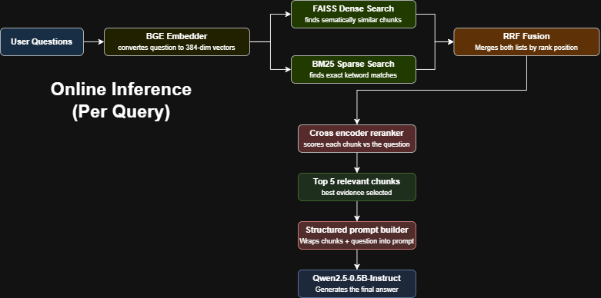
System Architecture
Offline Ingestion (once)
237 Docs
318K words
Semantic Chunker
BGE Embedder
FAISS + BM25 Index
3,356 chunks · 384-dim embeddings · Saved to disk
Semantic Chunker: Splits on topic boundaries detected via cosine similarity, not a particular word count.
BGE Embedder: Retrieval is optimised through contrastive training, useful for QA tasks.
FAISS: It finds conceptually similar content even when the exact words don't match.
BM25 Index: Keyword based retrieval it catches exact ingredient names and dish terms that dense search can miss.

Slide 6
What we Compared
Chunking:
Embedding:
Tried: 256words, 512 words, Sentenced based
Winner: Semantic Chunking (threshold=0.45)
Detects topic boundaries through cosine similarity
📊 Most impactful component: −0.192 ROUGE-L
Tried: MiniLM-L6-v2
Winner: BAAI/bge-small-en-v1.5 (384 dim)
Retrieval is optimised through contrastive training
📊 Better semantic similarity for QA retrieval
Retrieval:
Prompting:
Tried: FAISS (dense only), BM25 (sparse)
Winner: Hybrid + RRF + Cross-Encoder Reranker
RRF fuses ranked lists without score normalisation issues
📊 ROUGE-L: 0.353 vs BM25-only: 0.281
Tried: Zero-shot, Few-shot, Chain-of-thought
Winner: Structured / Constrained Prompting
Explicit format constraints reduce hallucination risk
📊 ROUGE-L: 0.353 vs zero-shot: 0.219

Slide 7
Results — RAG vs Baseline
+469%
Bleu-4 improvement
10.9%
Hallucination Rate (down from 100%)
20/23
Metrics Where RAG Wins
p<0.001
Statistical Significance (16 of 23 metrics)
Metric | Baseline | RAG | Improvement
BELU-4 | 0.025 | 0.139 | +469%
ROUGE-L | 0.154 | 0.328 | +113%
BERTScore F1 | 0.782 | 0.833 | +6.6%
METEOR | 0.218 | 0.321 | +46.8%
Answer F1 | 0.185 | 0.388 | +82.4%
Faithfulness | 0.113 | 0.655 | +479%
Hallucination rate | 100% | 10.9% | +89.1%
Retrieval Quality:
MRR@5: 0.908
Recall@5: 0.978
NDCG@5: 0.913
Latency: ~12s

Slide 8
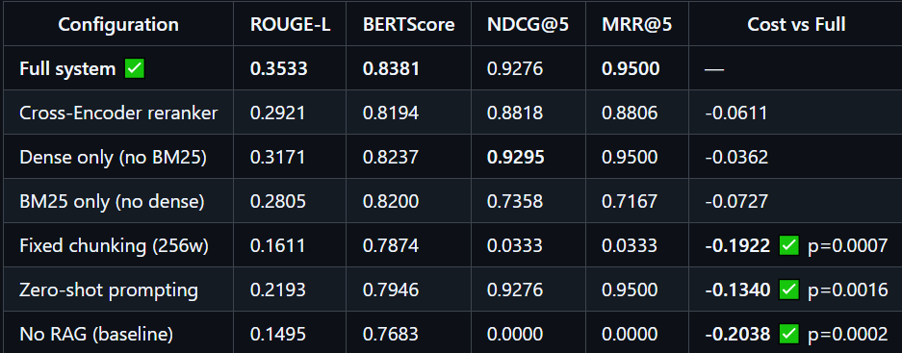
Ablation Study – What Actually Matters?

Slide 9
Ablation Study – What Actually Matters?
Key Findings:
Semantic chunking is the single most impactful component (−0.192 ROUGE-L).
1
Prompting quality (−0.134) matters more than retrieval strategy differences.
2
RAG context improves ROUGE-L by +0.204 vs no-context.
3
Every component contributes, nothing in the system is redundant, as seen with the ablation study.
4

Slide 10
THANK YOU

